Slide 1

GCSE: Probability
Dr J Frost (jfrost@tiffin.kingston.sch.uk)
Last modified: 26th April 2017

Slide 2
GCSE Specification
208. Write probabilities using fractions, percentages or decimals
209. Compare experimental data and theoretical probabilities. Compare relative frequencies from samples of different sizes.
210. Find the probability of successive events, such as several throws of a single die.
Identify different mutually exclusive outcomes and know that the sum of the probabilities of all these outcomes is 1.
211. Estimate the number of times an event will occur, given the probability and the number of trials.
212. List all outcomes for single events, and for two successive events, systematically. Use and draw sample space diagrams
213. Understand conditional probabilities. Use a tree diagram to calculate conditional probability.
214. Solve more complex problems involving combinations of outcomes.
215. Understand selection with or without replacement. Draw a probability tree diagram based on given information.

Slide 3
RECAP: How to write probabilities
Probability of winning the UK lottery:
?
?
1 in 14,000,000
___1___
14000000
Odds Form
Fractional Form
?
0.000000714
?
0.0000714%
Decimal Form
Percentage Form
Which is best in this case?

Slide 4
RECAP: Combinatorics
Combinatorics is the ‘number of ways of arranging something’.
We could consider how many things could do in each ‘slot’, then multiply these numbers together.
1
How many 5 letter English words could there theoretically be?
e.g.
B
I
L
B
O
26 x 26 x 26 x 26 x 26 = 26⁵
?
2
How many 5 letter English words with distinct letters could there be?
S
M
A
U
G
26 x 25 x 24 x 23 x 22 = 7893600
?
3
How many ways of arranging the letters in SHELF?
E
L
F
H
S
5 x 4 x 3 x 2 x 1 = 5! (“5 factorial”)
?

Slide 5
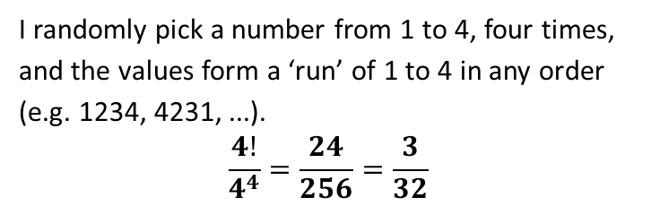
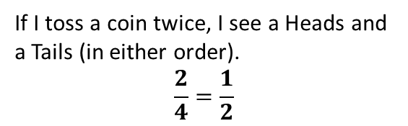
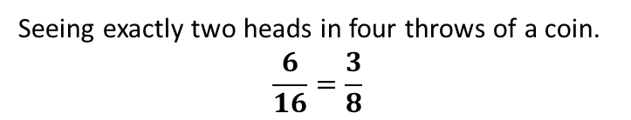
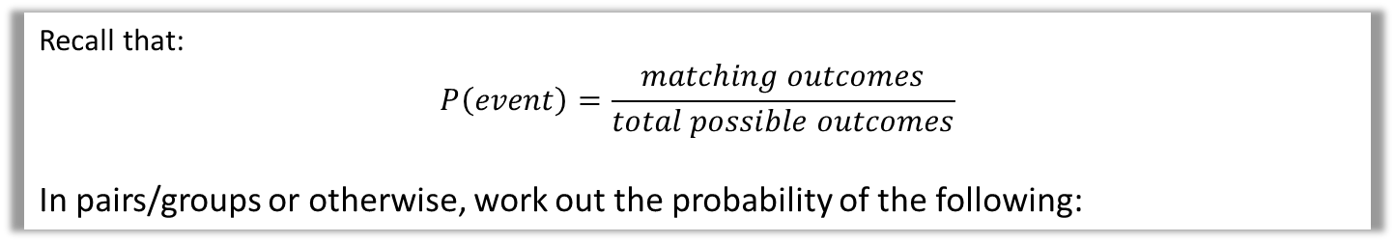
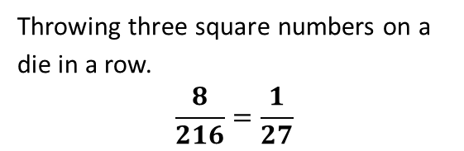
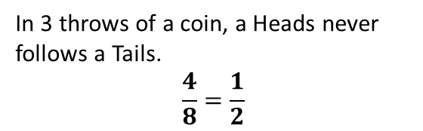
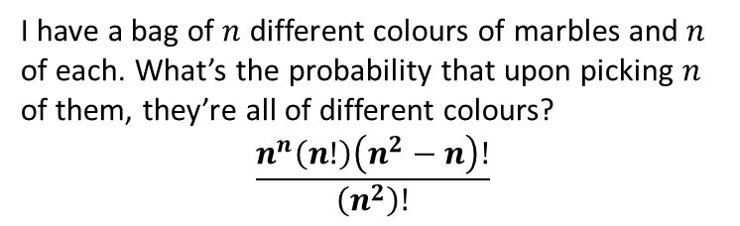
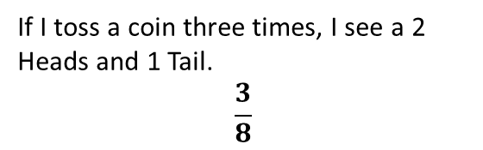
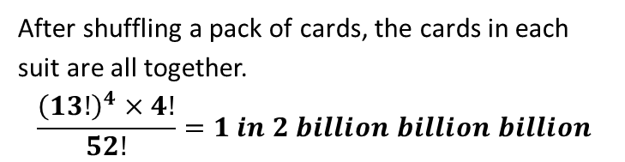
STARTER: Probability Puzzles
Recall that:
$$P\left(event\right)=\frac{matching outcomes}{total possible outcomes}$$
In pairs/groups or otherwise, work out the probability of the following:
1
If I toss a coin twice, I see a Heads and a Tails (in either order).
$$\frac{2}{4}=\frac{1}{2}$$
5
Seeing exactly two heads in four throws of a coin.
$$\frac{6}{16}=\frac{3}{8}$$
?
?
N
I randomly pick a number from 1 to 4, four times, and the values form a ‘run’ of 1 to 4 in any order (e.g. 1234, 4231, ...).
$$\frac{4!}{4^{4}}=\frac{24}{256}=\frac{3}{32}$$
2
If I toss a coin three times, I see a 2 Heads and 1 Tail.
$$\frac{3}{8}$$
?
?
3
In 3 throws of a coin, a Heads never follows a Tails.
$$\frac{4}{8}=\frac{1}{2}$$
After shuffling a pack of cards, the cards in each suit are all together.
$$\frac{{\left(13!\right)}^{4}×4!}{52!}=1 in 2 billion billion billion$$
NN
?
?
4
Throwing three square numbers on a die in a row.
$$\frac{8}{216}=\frac{1}{27}$$
I have a bag of $n$ different colours of marbles and $n$ of each. What’s the probability that upon picking $n$ of them, they’re all of different colours?
$$\frac{n^{n}\left(n!\right)\left(n^{2}−n\right)!}{\left(n^{2}\right)!}$$
NNN OMG
?
?

Slide 6

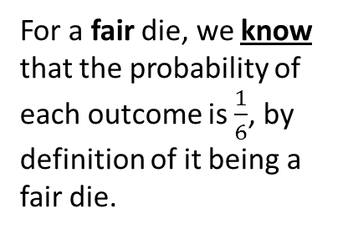

How can we find the probability of an event?
1. We might just know!
2. We can do an experiment and count outcomes
We could throw the dice 100 times for example, and count how many times we see each outcome.
For a fair die, we know that the probability of each outcome is $\frac{1}{6}$, by definition of it being a fair die.
Outcome | 1 | 2 | 3 | 4 | 5 | 6
Count | 27 | 13 | 10 | 30 | 15 | 5
?
R.F. | $$\frac{27}{100}$$ | $$\frac{13}{100}$$ | $$\frac{10}{100}$$ | $$\frac{30}{100}$$ | $$\frac{15}{100}$$ | $$\frac{5}{100}$$
This is known as a:
This is known as an:
Theoretical Probability
Experimental Probability
When we know the underlying probability of an event.
Also known as the relative frequency , it is a probability based on observing counts.
$$p\left(event\right)=\frac{count of outcome}{number of trials}$$
?
?

Slide 7
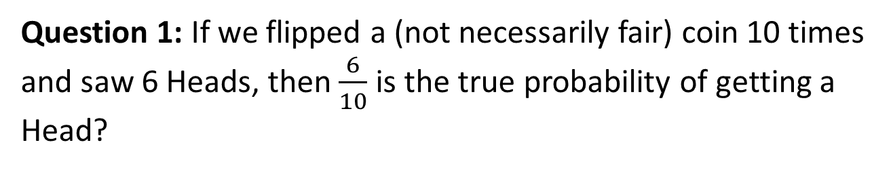
Check your understanding
Question 1: If we flipped a (not necessarily fair) coin 10 times and saw 6 Heads, then $\frac{6}{10}$ is the true probability of getting a Head?
?
No. It might for example be a fair coin: If we throw a fair coin 10 times we wouldn’t necessarily see 5 heads. In fact we could have seen 6 heads! So the relative frequency/experimental probability only provides a “sensible guess” for the true probability of Heads, based on what we’ve observed.
Question 2: What can we do to make the experimental probability be as close as possible to the true (theoretical) probability of Heads?
?
Flip the coin lots of times. I we threw a coin just twice for example and saw 0 Heads, it’s hard to know how unfair our coin is. But if we threw it say 1000 times and saw 200 heads, then we’d have a much more accurate probability.
The law of large events states that as the number of trials becomes large, the experimental probability becomes closer to the true probability.

Slide 8
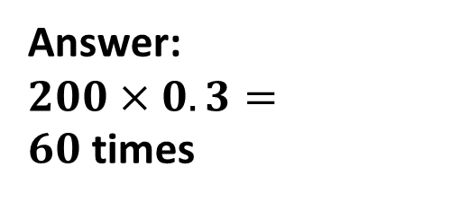

RECAP: Estimating counts and probabilities
A spinner has the letters A, B and C on it. I spin the spinner 50 times, and see A 12 times. What is the experimental probability for P(A)?
?
Answer: $\frac{12}{50}=0.24$
The probability of getting a 6 on an unfair die is 0.3. I throw the die 200 times. How many sixes might you expect to get?
Answer:
$200×0.3=60$times
?

Slide 9
Test Your Understanding
A
The table below shows the probabilities for spinning an A, B and C on a spinner. If I spin the spinner 150 times, estimate the number of Cs I will see.
Outcome | A | B | C
Probability | 0.12 | 0.34
A
B
C
?
P(C) = 1 – 0.12 – 0.34 = 0.54
Estimate Cs seen = 0.54 x 150 = 81
B
I spin another spinner 120 times and see the following counts:
What is the relative frequency of B?
45/120 = 0.375
Outcome | A | B | C
Count | 30 | 45 | 45
A
B
C
?

Slide 10
So far…
✓
208. Write probabilities using fractions, percentages or decimals
209. Compare experimental data and theoretical probabilities. Compare relative frequencies from samples of different sizes.
210. Find the probability of successive events, such as several throws of a single die.
Identify different mutually exclusive outcomes and know that the sum of the probabilities of all these outcomes is 1.
211. Estimate the number of times an event will occur, given the probability and the number of trials.
212. List all outcomes for single events, and for two successive events, systematically. Use and draw sample space diagrams
213. Understand conditional probabilities. Use a tree diagram to calculate conditional probability.
214. Solve more complex problems involving combinations of outcomes.
215. Understand selection with or without replacement. Draw a probability tree diagram based on given information.
✓
✓

Slide 11


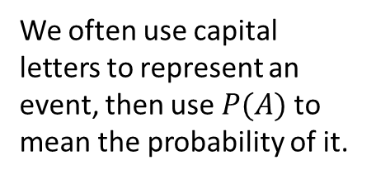
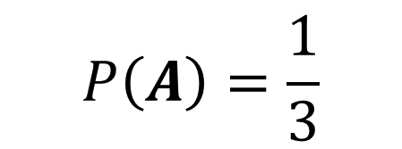

RECAP: Events
Examples of events:
Throwing a 6, throwing an odd number, tossing a heads, a randomly chosen person having a height above 1.5m.
The sample space is the set of all outcomes.
An event is a description of one or more outcomes. It is a subset of the sample space.
?
?
$$ξ$$
The sample space
$$A$$
$$B$$
$$P\left(A\right)=\frac{1}{3}$$
2
3
5
We often use capital letters to represent an event, then use $P(A)$ to mean the probability of it.
1
From Year 7 you should be familiar with representing sets using a Venn Diagram, although you won’t need to at GCSE.

Slide 12
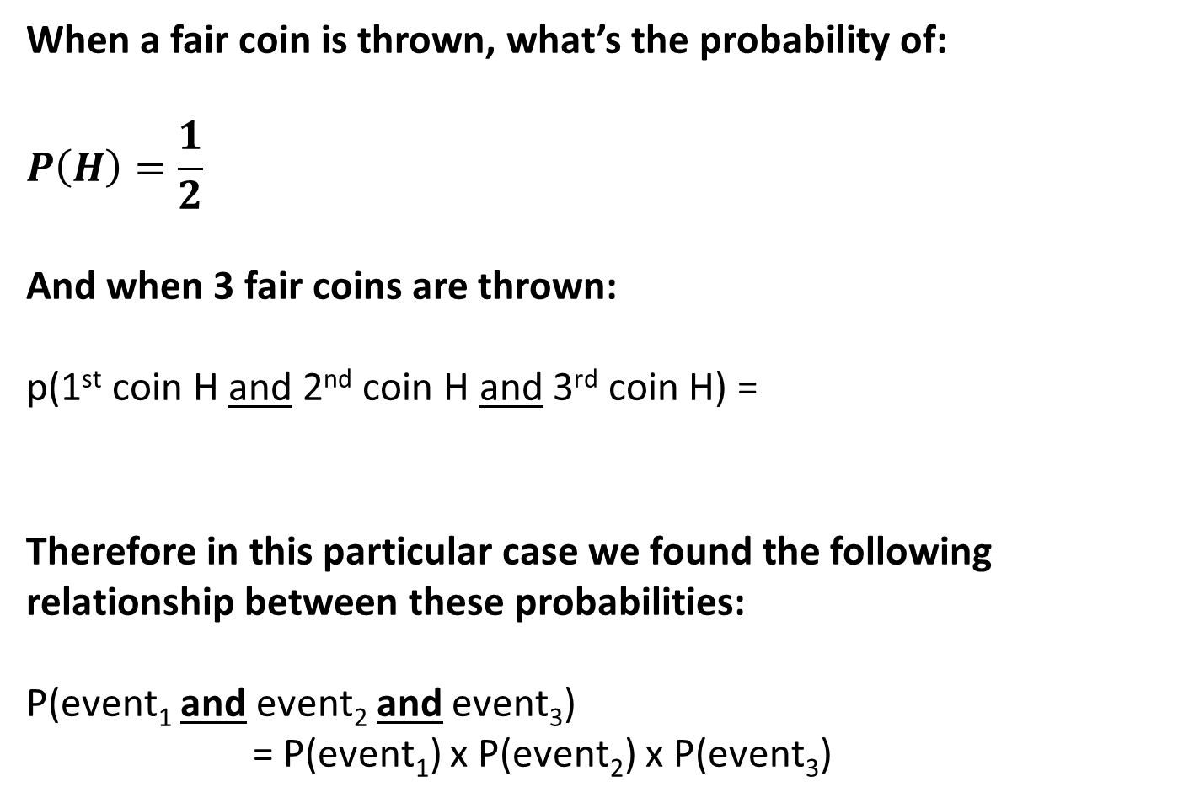
Independent Events !
When a fair coin is thrown, what’s the probability of:
$$P\left(H\right)=\frac{1}{2}$$
And when 3 fair coins are thrown:
p(1st coin H and 2nd coin H and 3rd coin H) =
Therefore in this particular case we found the following relationship between these probabilities:
P(event₁ and event₂ and event₃)
= P(event₁) x P(event₂) x P(event₃)
?
?
1
8
?

Slide 13
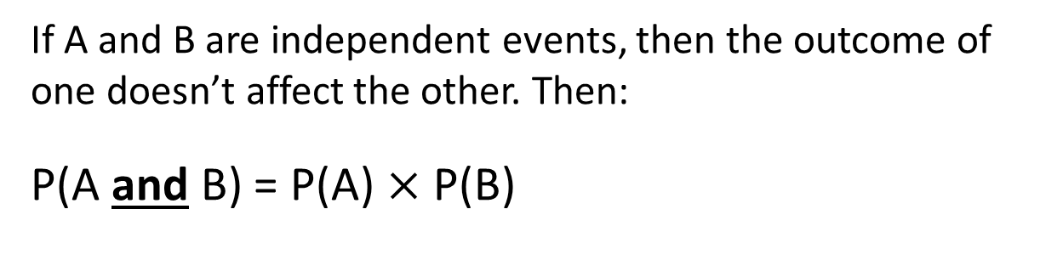
!Mutually Exclusive Events
If A and B are mutually exclusive events, they can’t happen at the same time. Then:
P(A or B) = P(A) + P(B)
! Independent Events
If A and B are independent events, then the outcome of one doesn’t affect the other. Then:
P(A and B) = P(A) $×$ P(B)

Slide 14
But be careful…
1 2 3 4 5 6 7 8
1
2
?
P(num divisible by 2) =
?
P(num divisible by 4) =
1
4
?
1
4
P(num divisible by 2 and by 4) =
Why would it have been wrong to multiply the probabilities?

Slide 15
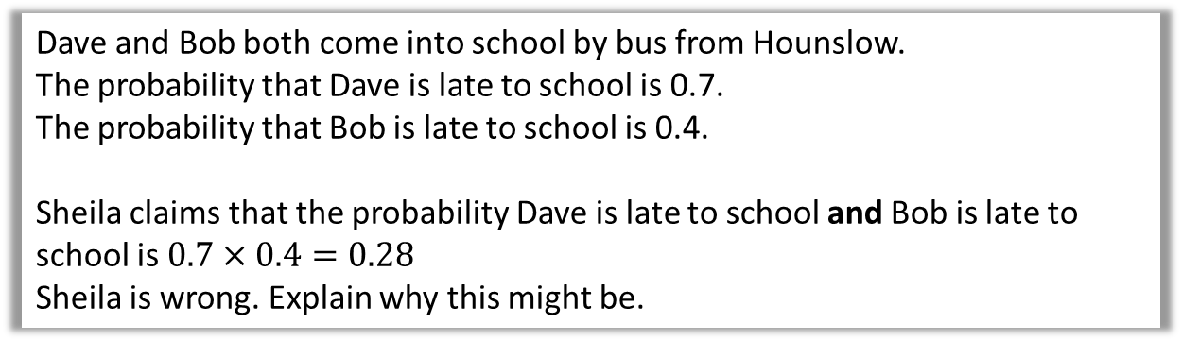
Relevant exam style question…
Dave and Bob both come into school by bus from Hounslow.
The probability that Dave is late to school is 0.7.
The probability that Bob is late to school is 0.4.
Sheila claims that the probability Dave is late to school and Bob is late to school is $0.7×0.4=0.28$
Sheila is wrong. Explain why this might be.
?
The events are likely to not be independent, therefore we can’t multiply the probabilities.
The events are connected, e.g. if Dave is late, then Bob may be on the same bus and therefore more likely to be late too.

Slide 16
Add or multiply probabilities?
✗
+
✓
×
Getting a 6 on a die and a T on a coin.
✓
+
✗
×
Hitting a bullseye or a triple 20.
Getting a HHT or a THT after three throws of an unfair coin (presuming we’ve already worked out P(HHT) and P(THT).
✓
+
✗
×
Getting 3 on the first throw of a die and a 4 on the second.
✗
+
✓
×
Bart’s favourite colour being red and Pablo’s being blue.
✗
+
✓
×
✓
+
✗
×
Shaan’s favourite colour being red or blue.

Slide 17
Independent?
Event 1
Event 2
Throwing a heads on the first flip.
Throwing a heads on the second flip.
✗
✓
No
Yes
It rains tomorrow.
It rains the day after.
✓
No
✗
Yes
That I will choose maths at A Level.
That I will choose Physics at A Level.
✓
No
✗
Yes
Have a garden gnome.
Being called Bart.
✗
✓
No
Yes

Slide 18
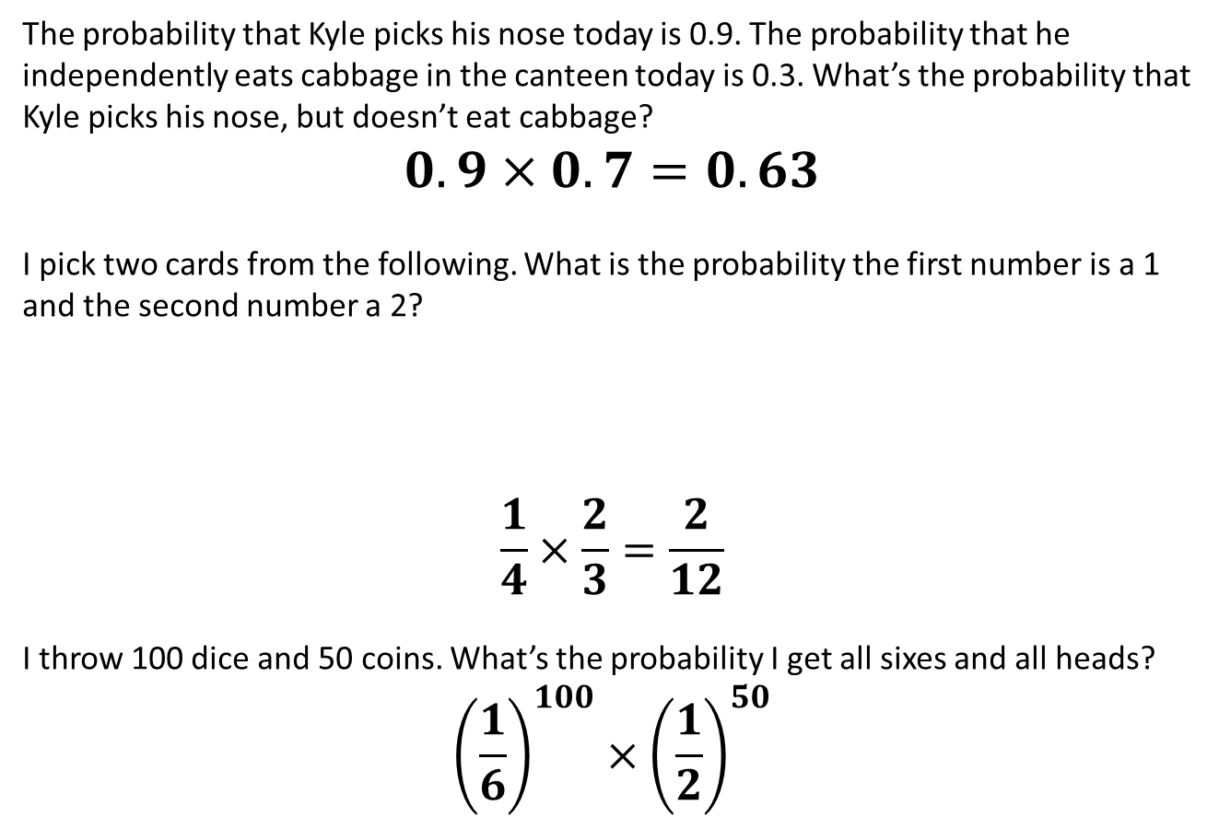
Test Your Understanding
a
The probability that Kyle picks his nose today is 0.9. The probability that he independently eats cabbage in the canteen today is 0.3. What’s the probability that Kyle picks his nose, but doesn’t eat cabbage? $$0.9×0.7=0.63$$
I pick two cards from the following. What is the probability the first number is a 1 and the second number a 2?
$$\frac{1}{4}×\frac{2}{3}=\frac{2}{12}$$
I throw 100 dice and 50 coins. What’s the probability I get all sixes and all heads?
$${\left(\frac{1}{6}\right)}^{100}×{\left(\frac{1}{2}\right)}^{50}$$
?
b
1
2
2
3
?
c
?

Slide 19
Tree Diagrams
Question: Given there’s 5 red balls and 2 blue balls. What’s the probability that after two picks we have a red ball and a blue ball?
Bro Tip: Note that probabilities generally go on the lines, and events at the end.
After first pick, there’s less balls to choose from, so probabilities change.
4
6
?
R
?
5
7
R
?
B
2
6
5
6
R
?
2
7
?
B
1
6
B
?

Slide 20
Tree Diagrams
Question: Give there’s 5 red balls and 2 blue balls. What’s the probability that after two picks we have a red ball and a blue ball?
We multiply across the matching branches, then add these values.
4
6
R
5
7
R
5
21
B
?
2
6
5
6
R
5
21
?
2
7
B
1
6
B
10
21
?
P(red and blue) =

Slide 21
Summary
...with replacement:
The item is returned before another is chosen. The probability of each event on each trial is fixed.
...without replacement:
The item is not returned.
Total balls decreases by 1 each time.
Number of items of this type decreases by 1.
Note that if the question doesn’t specify which, e.g. “You pick two balls from a bag”, then PRESUME WITHOUT REPLACEMENT.

Slide 22
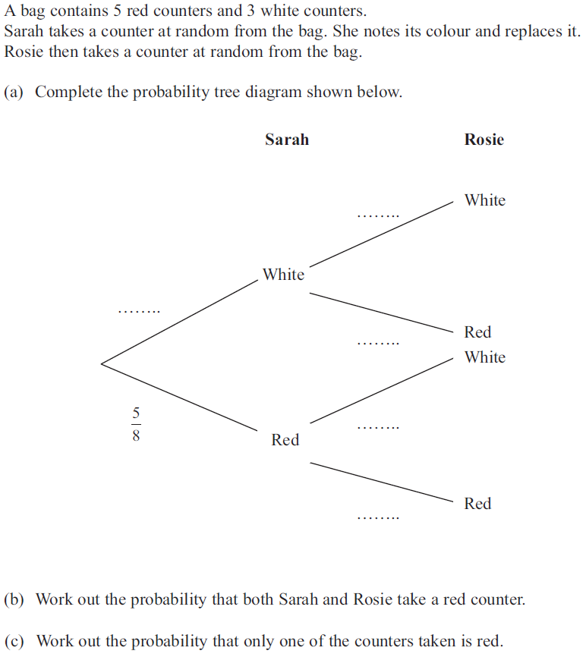


Example (on your sheet)
?
3
8
?
3
8
?
5
8
?
$$\frac{5}{8}×\frac{5}{8}=\frac{25}{64}$$
?
3
8
?
5
8
?
$$\left(\frac{3}{8}×\frac{5}{8}\right)+\left(\frac{5}{8}×\frac{3}{8}\right) \\ =\frac{15}{32}$$

Slide 23
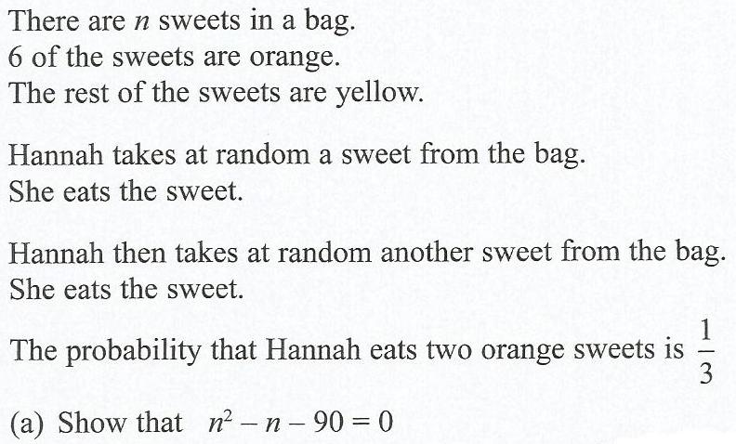

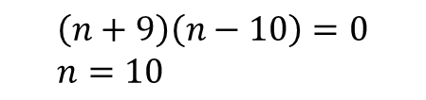
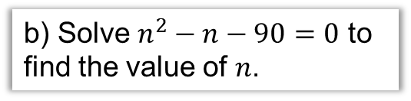
Algebraic Probability Questions
This question famously made national news…
?
b) Solve $n^{2}−n−90=0$ to find the value of $n$.
Probability both orange:
$$\frac{6}{n}×\frac{5}{n−1}=\frac{1}{3}$$
$$\frac{30}{n(n−1)}=\frac{1}{3}$$
$$90=n\left(n−1\right) \\ n^{2}−n=90 \\ n^{2}−n−90=0$$
?
$$\left(n+9\right)\left(n−10\right)=0 \\ n=10$$
‘Cross multiply’

Slide 24
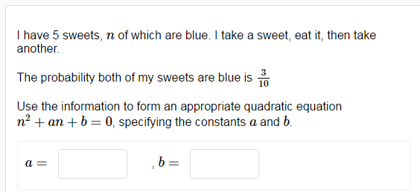
Test Your Understanding
From DrFrostMaths homework platform…
-1
-6
?
?

Slide 25
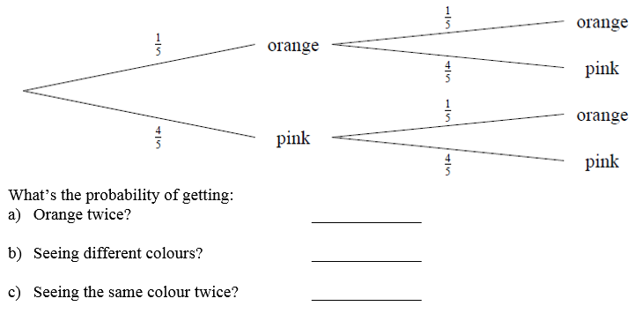


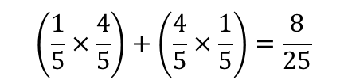
Question 1
?
$$\frac{1}{5}×\frac{1}{5}=\frac{1}{25}$$
?
$$\left(\frac{1}{5}×\frac{4}{5}\right)+\left(\frac{4}{5}×\frac{1}{5}\right)=\frac{8}{25}$$
$$1−\frac{8}{25}=\frac{17}{25}$$
?

Slide 26
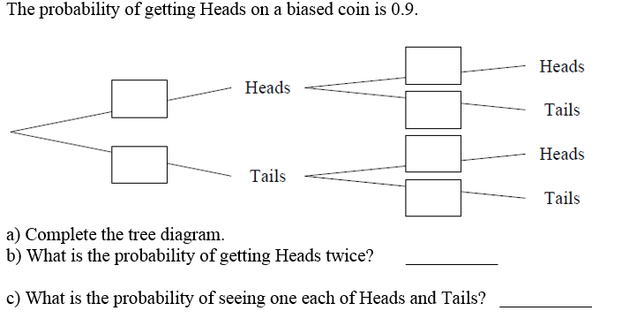








Question 2
?
$$0.9$$
?
$$0.9$$
$$0.1$$
?
$$0.9$$
$$0.1$$
$$0.1$$
?
$${0.9}^{2}=0.81$$
?
$$2×0.1×0.9=0.18$$

Slide 27
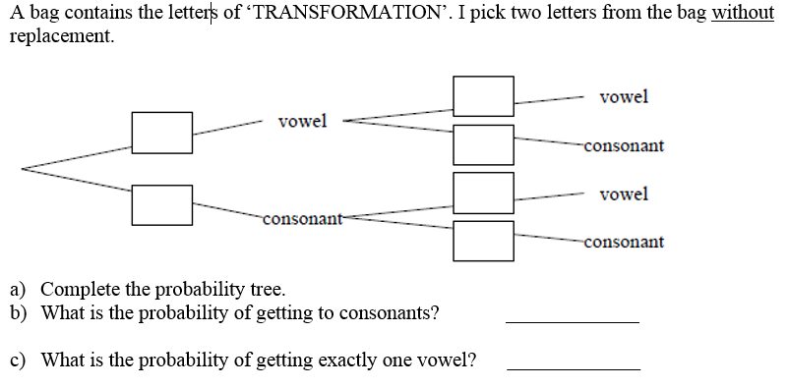





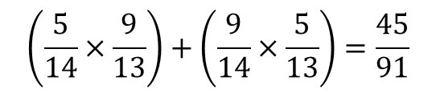

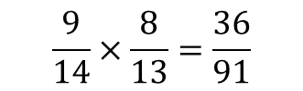
Question 3
?
$$\frac{4}{13}$$
$$\frac{5}{14}$$
?
$$\frac{9}{13}$$
$$\frac{5}{13}$$
$$\frac{9}{14}$$
?
$$\frac{8}{13}$$
$$\frac{9}{14}×\frac{8}{13}=\frac{36}{91}$$
?
two consonants?
$$\left(\frac{5}{14}×\frac{9}{13}\right)+\left(\frac{9}{14}×\frac{5}{13}\right)=\frac{45}{91}$$
?

Slide 28
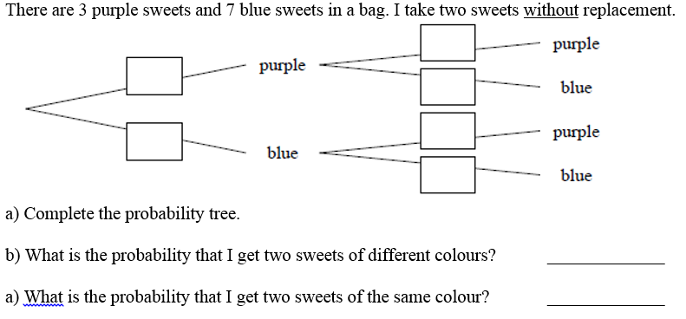







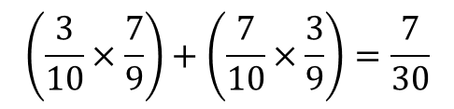
Question 4
$$\frac{2}{9}$$
?
$$\frac{3}{10}$$
?
$$\frac{7}{9}$$
$$\frac{3}{9}$$
$$\frac{7}{10}$$
?
$$\frac{6}{9}$$
$$\left(\frac{3}{10}×\frac{7}{9}\right)+\left(\frac{7}{10}×\frac{3}{9}\right)=\frac{7}{30}$$
?
?
$$1−\frac{7}{30}=\frac{23}{30}$$

Slide 29
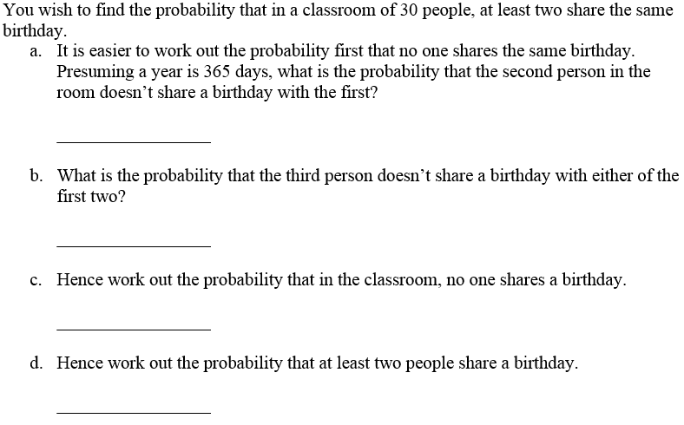

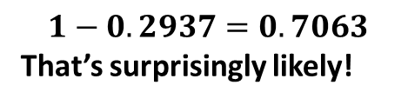
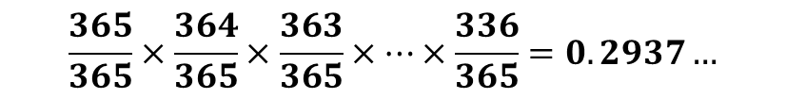

Question 5 – “The Birthday Paradox”
$$\frac{364}{365}$$
?
$$\frac{363}{365}$$
?
$$\frac{365}{365}×\frac{364}{365}×\frac{363}{365}×…×\frac{336}{365}=0.2937…$$
?
$$1−0.2937=0.7063$$
That’s surprisingly likely!
?

Slide 30
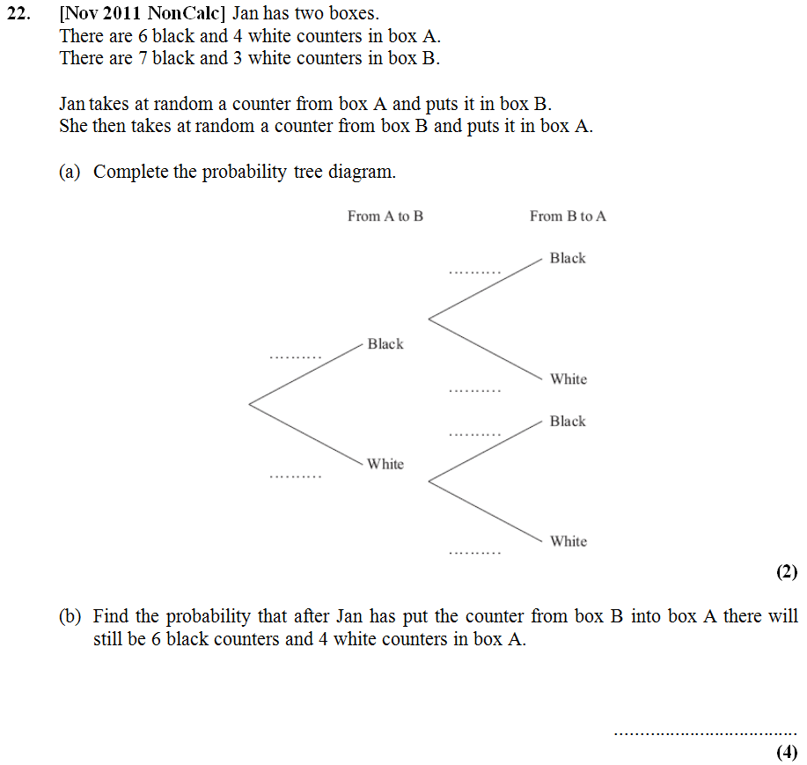
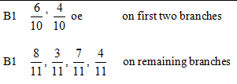
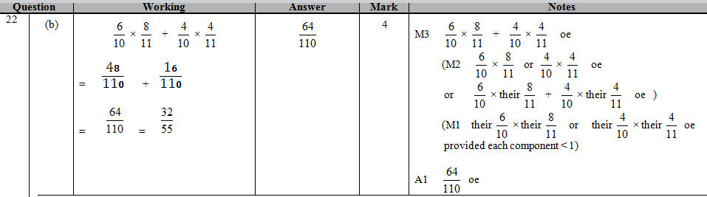
Question 6
?
?
64
110

Slide 31
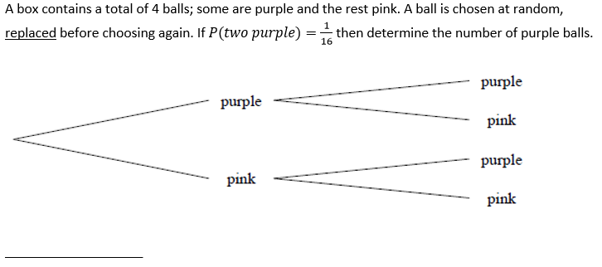



Question 7 (Algebraic Trees)
$$\frac{p}{4}$$
$$\frac{p}{4}$$
?
$$\frac{p}{4}×\frac{p}{4}=\frac{1}{16} \\ \frac{p^{2}}{16}=\frac{1}{16} \\ p^{2}=1 \\ p=1$$

Slide 32
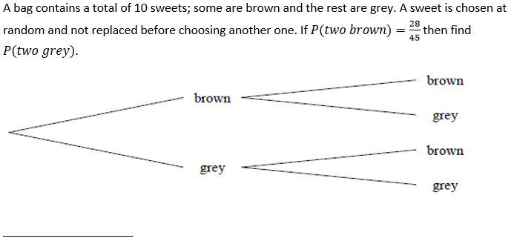


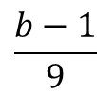
Question 8
$$\frac{b−1}{9}$$
$$\frac{b}{10}$$
?
$$\frac{b}{10}×\frac{b−1}{9}=\frac{b\left(b−1\right)}{90}=\frac{28}{45} \\ b\left(b−1\right)=56 \\ b^{2}−b=56 \\ b^{2}−b−56=0 \\ \left(b+7\right)\left(b−8\right)=0 \\ b=8$$
$$∴P\left(GG\right)=\frac{2}{10}×\frac{1}{9}=\frac{2}{90}=\frac{1}{45}$$

Slide 33
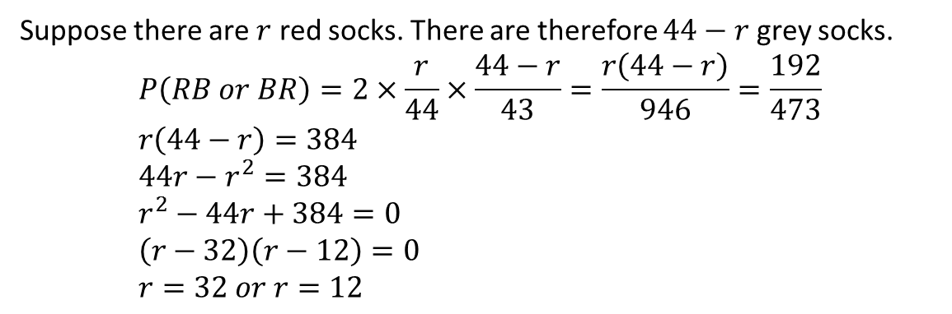
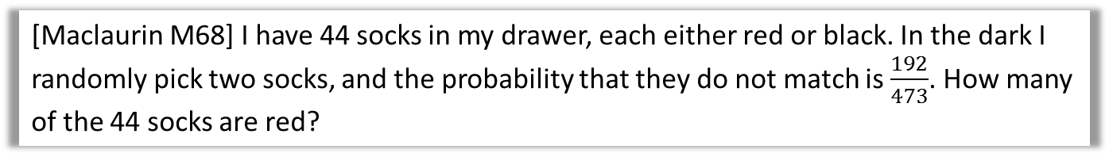
Question N₁
[Maclaurin M68] I have 44 socks in my drawer, each either red or black. In the dark I randomly pick two socks, and the probability that they do not match is $\frac{192}{473}$. How many of the 44 socks are red?
?
Suppose there are $r$ red socks. There are therefore $44−r$ grey socks.
$$P\left(RB or BR\right)=2×\frac{r}{44}×\frac{44−r}{43}=\frac{r\left(44−r\right)}{946}=\frac{192}{473} \\ r\left(44−r\right)=384 \\ 44r−r^{2}=384 \\ r^{2}−44r+384=0 \\ \left(r−32\right)\left(r−12\right)=0 \\ r=32 or r=12$$

Slide 34


Question N₂
[Maclaurin 2013 Q4] Two coins are biased in such a way that, when they are both tossed once: (i) the probability of getting two heads is the same as the probability of getting two tails; (ii) the probability of getting one head and one tail is $\frac{5}{8}$. For each coin, what is the probability of getting a head?
Let the probability of coin 1 being Heads be $x$ and the probability of coin 2 being Heads $y$.
Then using (i):
$$xy=\left(1−x\right)\left(1−y\right) \\ xy=1−x−y+xy \\ y=1−x$$
Then using (ii):
$$x\left(1−y\right)+y\left(1−x\right)=\frac{5}{8} \\ x−xy+y−xy=\frac{5}{8} \\ 1−2x\left(1−x\right)=\frac{5}{8} \\ 1−2x+{2x}^{2}=\frac{5}{8} \\ 16x^{2}−16x+3=0 \\ \left(4x−1\right)\left(4x−3\right)=0 \\ x=\frac{1}{4} or\frac{3}{4}$$
(and thus the other coin would be $y=\frac{3}{4}$ or $y=\frac{1}{4}$)
?

Slide 35


Doing without a tree: Listing outcomes
It’s usually quicker to just list the outcomes rather than draw a tree.
BGG:
GBG:
GGB:
$$\frac{14}{31}×\frac{17}{30}×\frac{16}{29}=\frac{1904}{13485}$$
$$\frac{17}{31}×\frac{14}{30}×\frac{16}{29}=\frac{1904}{13485}$$
$$\frac{17}{31}×\frac{16}{30}×\frac{14}{29}=\frac{1904}{13485}$$
? Working
1904
4495
Answer =
?

Slide 36

Test Your Understanding
Q
I have a bag consisting of 6 red balls, 4 blue and 3 green. I take three balls out of the bag at random. Find the probability that the balls are the same colour. RRR: $\frac{6}{13}×\frac{5}{12}×\frac{4}{11}=\frac{120}{1716}$
GGG: $\frac{3}{13}×\frac{2}{12}×\frac{1}{11}=\frac{6}{1716}$
BBB: $\frac{4}{13}×\frac{3}{12}×\frac{2}{11}=\frac{24}{1716}$
$P\left(same colour\right)=\frac{150}{1716}=\frac{25}{286}$
What’s the probability they’re of different colours:
RGB: $\frac{6}{13}×\frac{4}{12}×\frac{3}{11}=\frac{6}{143}$
Each of the $3!=6$ orderings of RGB will have the same probability.
So $\frac{6}{143}×6=\frac{36}{143}$
?
N
?

Slide 37
Probability Past Paper Questions
Provided on sheet.
Remember:
List the possible events that match.
Find the probability of each (by multiplying).
Add them together.

Slide 38


Past Paper Questions
?

Slide 39


Past Paper Questions
?

Slide 40


Past Paper Questions
?

Slide 41



Past Paper Questions
?
2
42
?
16
42

Slide 42



Past Paper Questions
?
222
380

Slide 43
Past Paper Questions
?
?
64
110

Slide 44


Past Paper Questions
?

Slide 45


Past Paper Questions
?

